Slide 1
MindGames
CAPSTONE PROJECT PRESENTATION
Brandon Knotek (bk11@hood.edu) Walid Muhammad (wm5@hood.edu) Jack Wilder (jmw38@hood.edu)

Slide 2
Our Goal
Neurofeedback to control real-time interactive experiences

Slide 3
Our Goal
Neurofeedback to control real-time interactive experiences
Play Pac-Man just by thinking commands
No mouse, No keyboard, No voice

Slide 4
Project Motivation
Accessibility
Physical disabilities
Communication
Locked In Syndrome
Immersive Experiences
Games and simulations

Slide 5
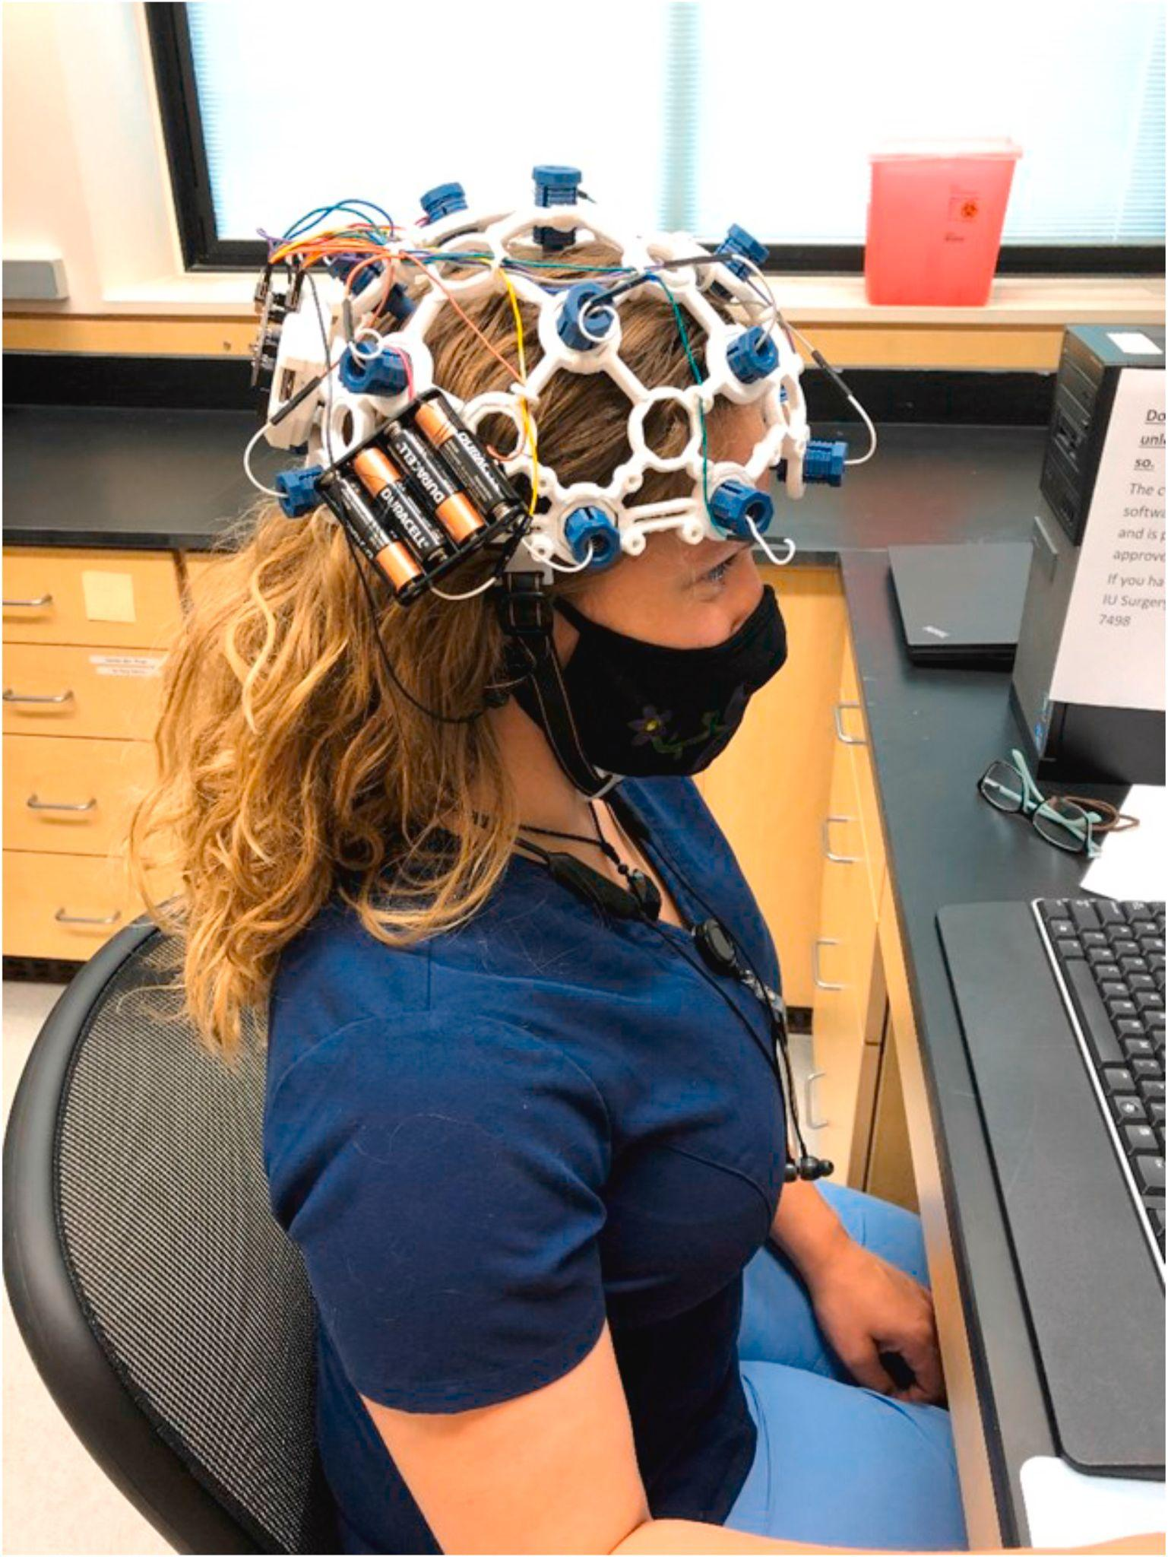
System Requirements
1. Brain Activity
Signals
2. Computer Processing
3. Game Commands
Fig. 1 - Using an OpenBCI Ultracortex headset to interact with a computer

Slide 6
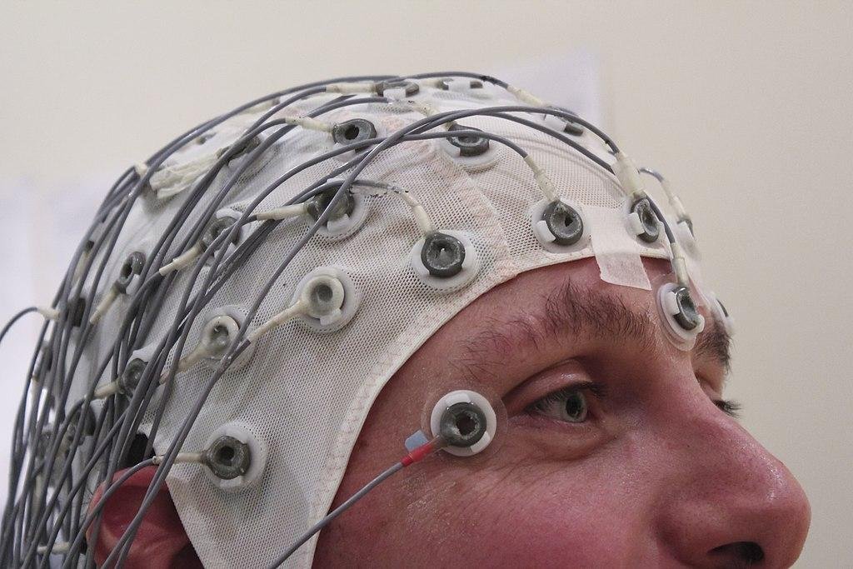
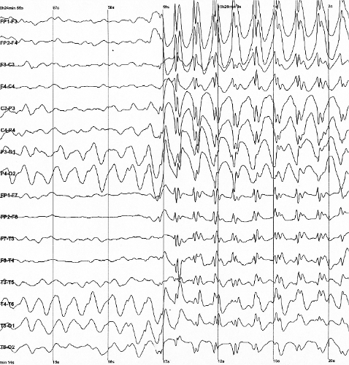
Unraveling the Brain
All brain activity = electrical
Electroencephalography (EEG) uses electrodes to measure activity
Different thoughts, actions, and mental states produce unique electrical patterns
Patterns differ between individuals
Fig. 2 - An example of EEG hardware
Fig. 3 - Sample EEG output

Slide 7
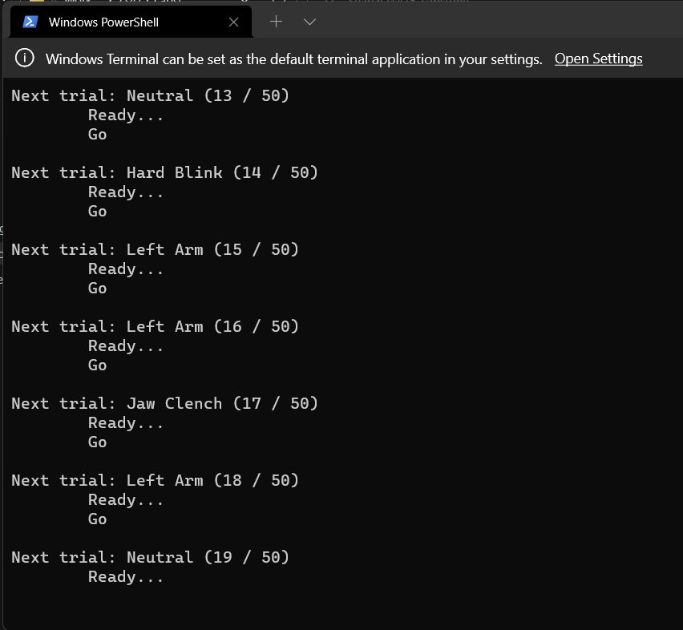
Building a Neural Fingerprint
Computer training:
Analyze an individual’s unique patterns
Machine Learning (ML):
Computer associates labeled patterns with commands
Fig. 4 - Calibration module collecting training data

Slide 8
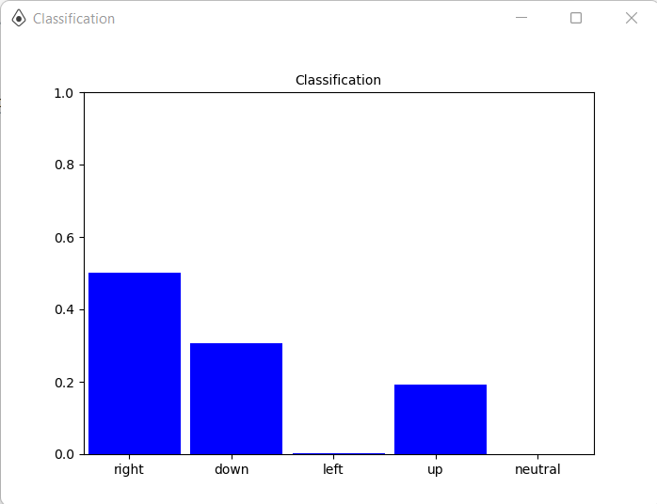
Command Classification
Enough examples for ML model to classify patterns on its own
Probabilistic:
Determines most likely command given pattern
Fig. 5 - Visualization of model’s classification output

Slide 9
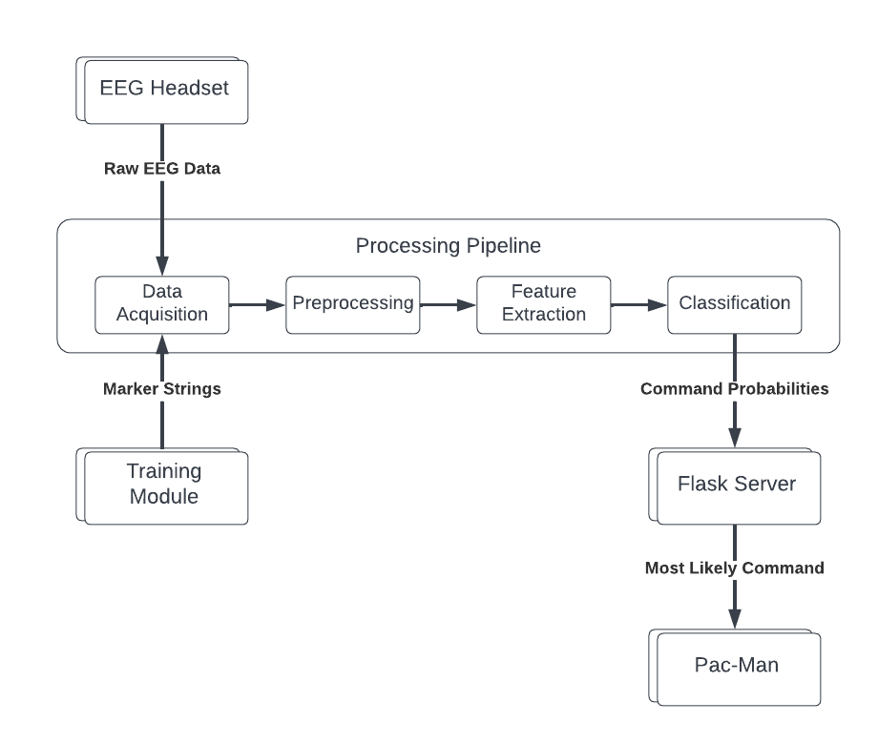
System Overview
Fig. 6 - A diagram of the MindGames system architecture

Slide 10
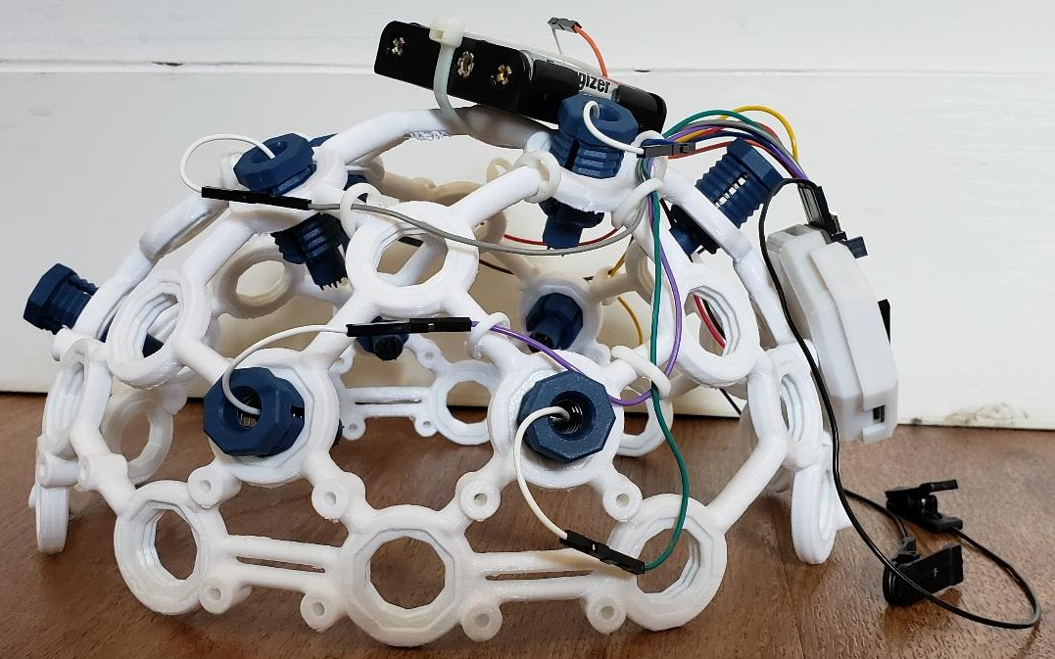
Collecting Data
EEG Signals
Spike electrodes
OpenBCI Daisy Biosensing Board
OpenBCI Ultracortex Mk 4 headset
ML Training Labels
Training module
Data synchronized, sent to processing pipeline
Fig. 7 - Ultracortex headset, profile view

Slide 11
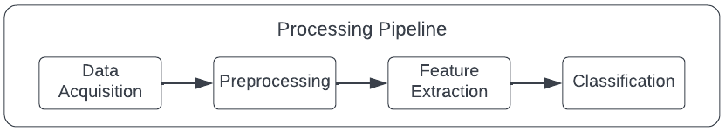
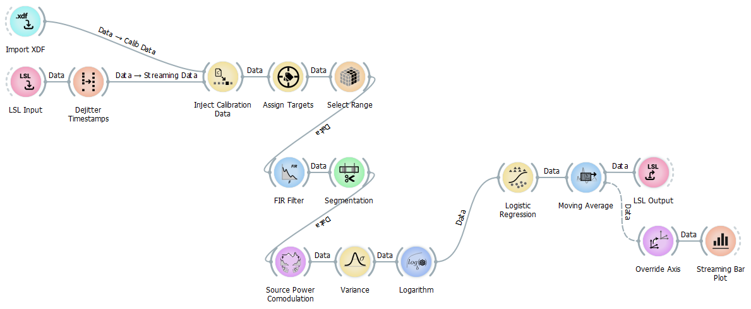
EEG Processing Pipeline
Fig. 8 - MindGames EEG processing pipeline simplified view
Fig. 9 - MindGames EEG processing pipeline detailed view

Slide 12
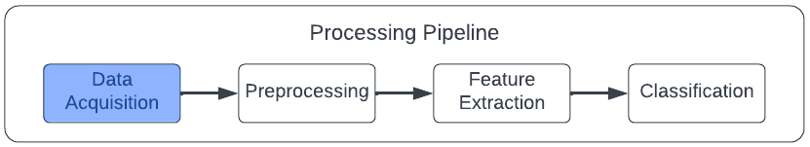
EEG Processing Pipeline
Fig. 10 - EEG pipeline data acquisition component
Notes:
Data Acquisition
Get EEG data and ML training labels into the pipeline
Assign training labels to commands
Preprocessing
Filter out electrical noise
Designate length of data “chunks” to associate with labels
Feature Extraction
Extract EEG signal components that exhibit the most variance between commands
Reduce the volume of data to make ML classification more efficient
Classification
Use extracted features to determine command probabilities
Maintain a moving average of probabilities to reduce noise
Output list of probabilities

Slide 13
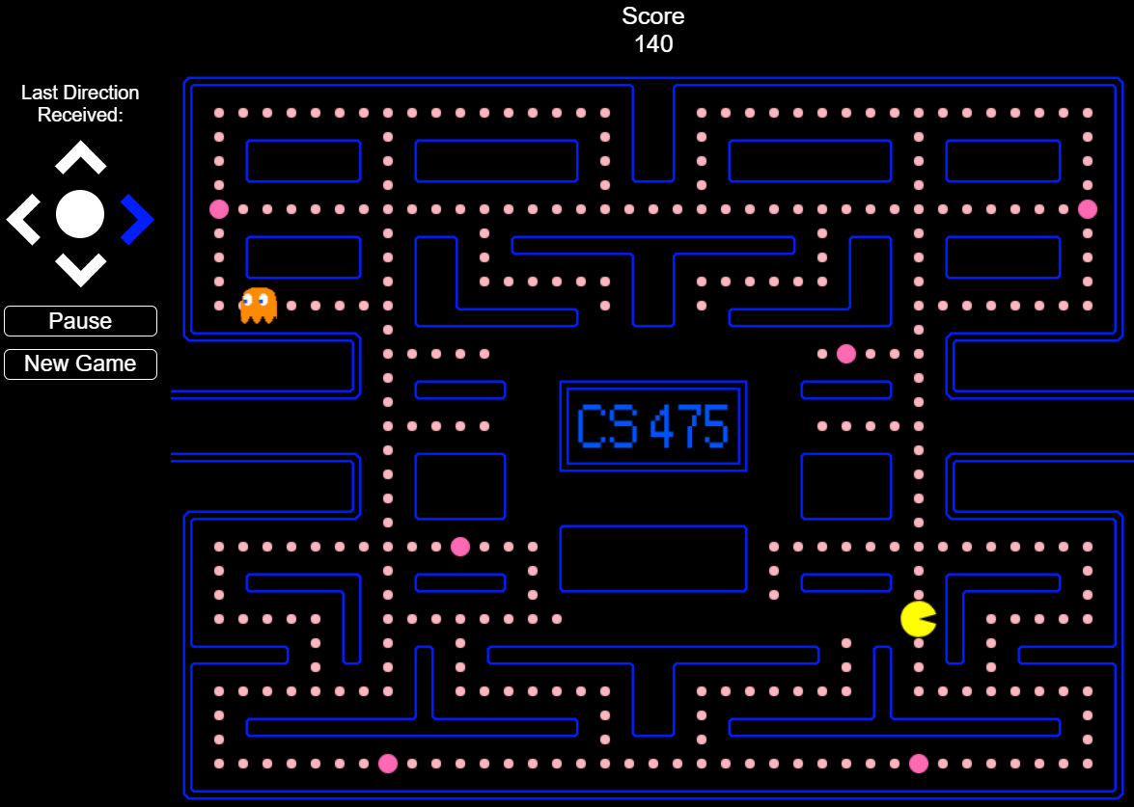
Using Commands
Fig. 14 - Pac Man in action
Notes:
List of probabilities received by Flask backend
Highest probability extracted
Corresponding command sent to Pac-Man webfront
Command executed in-game

Slide 14


Accomplished Work
Pac-Man web-frontend
Javascript, HTML, CSS
Flask backend
Python
OpenBCI Specific Development and Communication Tools
Notes:
Pac-Man webfront
Javascript, HTML, CSS
Flask backend
Python
Node-based EEG processing pipeline
NeuroPype Pipeline Designer
Communication between components
Lab Streaming Layer, WebSocket API

Slide 15
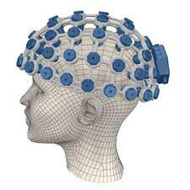
Challenges
Training time
Hardware Limitations
Noise and unrelated spikes
Thought to Action Latency
Fig. 15 - OpenBCI Headset with Additional Nodes
Notes:
HARDWARE
OpenBCI Ultracortex headset
8 electrodes (professional: 128)
Difficult to secure
Small movements cause it to shift position
Electrodes move with headset
RESULT:
Low quality data (and not enough of it)
SOFTWARE
Training time: 8 minutes
Results subject to hardware challenges
Noise and unrelated spikes (e.g., blinking, swallowing)
Must be filtered out without affecting relevant signals
Thought to Action
Minimal latency for the game to feel responsive

Slide 16
Lessons Learned and Future Work
Upgrade our EEG hardware
Fine-tune our noise reduction and ML classification techniques
Transition from classifying movements to classifying imagined movements (motor imagery)
Notes:
ML requires a lot of data
EEG signals are noisy
EEG hardware limitations
Powerful computer needed for real-time signal processing

Slide 17
Questions?

